Slide 1
How to work with GIT

Slide 2
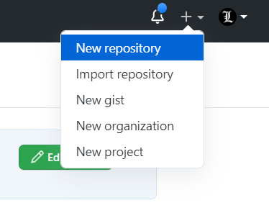
Step 1
To create a new repository, select New Repository from the + sign dropdown menu

Slide 3
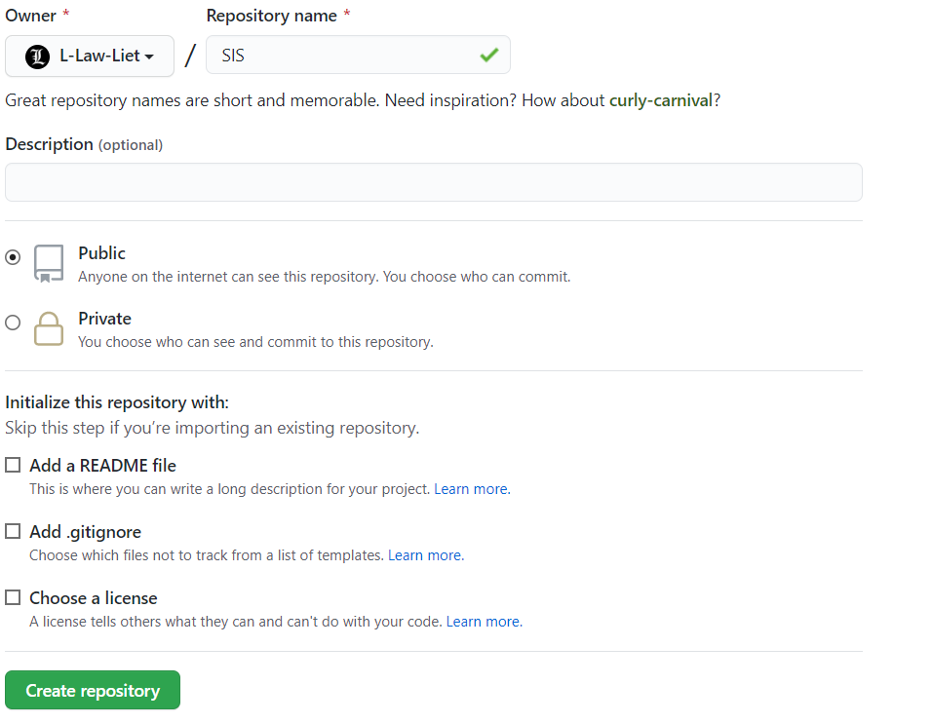
Step 2
Enter a name for your repository, description, etc. and click Create Repository.

Slide 4
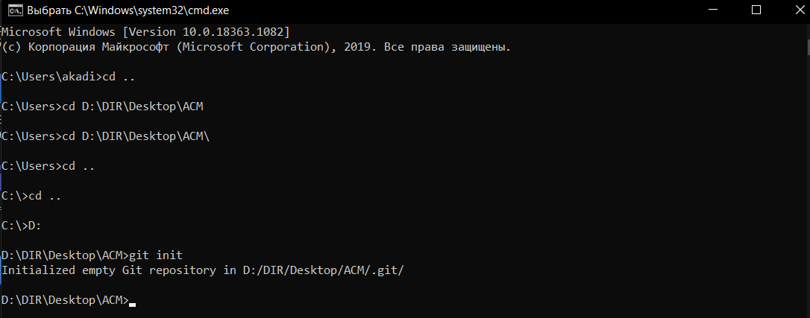
Step 3
Then you need to go to the command line and go to the desired directory. And in this directory, you need to write the git init command. this command will initialize in this directory

Slide 5
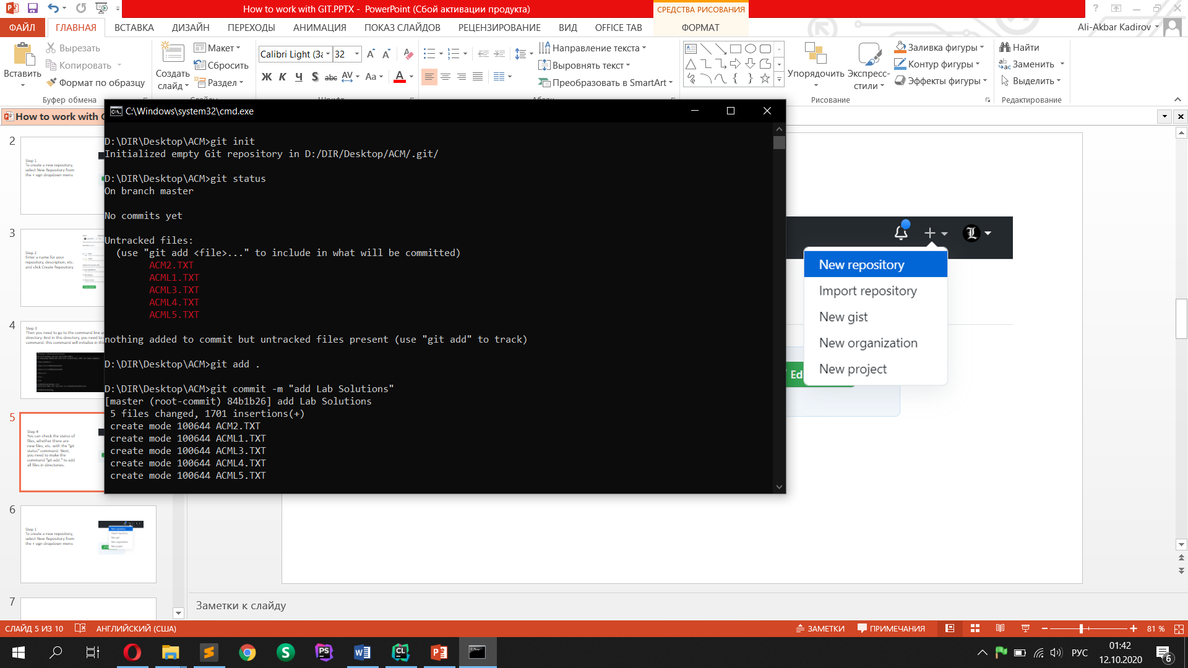
Step 4
You can check the status of files, whether there are new files, etc. with the "git status" command. Next, you need to make the command "git add ." to add all files in directories.

Slide 6
Step 5
You need to write 'git commit -m "your comment"' in order to mark your submission -m means that we send any message and then write our comment in double brackets.

Slide 7
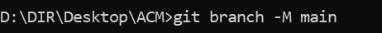
Step 6
Then to create a new branch you need to write "git branch -M branchName". to add from this branch. This can be useful when several programmers are working on a project and everyone is sitting on their own branch and throwing commits, in order to upload a friend's commit, you need to write "git pull".

Slide 8
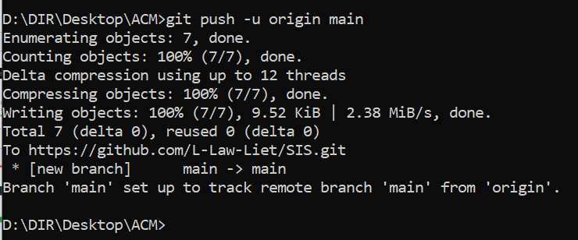
Step 7
To send changes to the git, you need to write "git push". In our case, we are sending from the main branch.

Slide 9
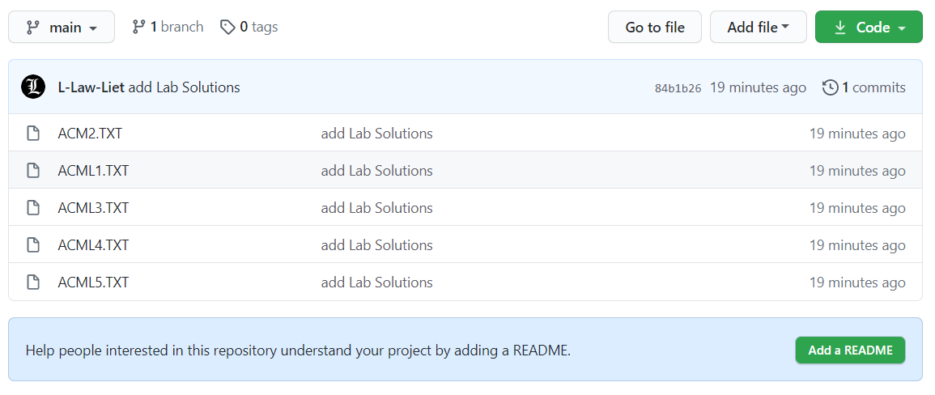
After refreshing our page you’ll see your commit

Slide 10
That’s all

